Slide 1
Lecture 3 – Introduction to probability
OPIM 5603 – Statistics in Business Analytics

Slide 2
Outline
Introduction to Probability
Basic probability definitions
Marginal and joint probabilities
Addition and multiplication rules
Conditional probability
Bayes Theorem
Counting Rules (combinatorics)
R
Rep and seq
Reading data from file
Plotting and tables
Data Frames
Lists
Functions

Slide 3
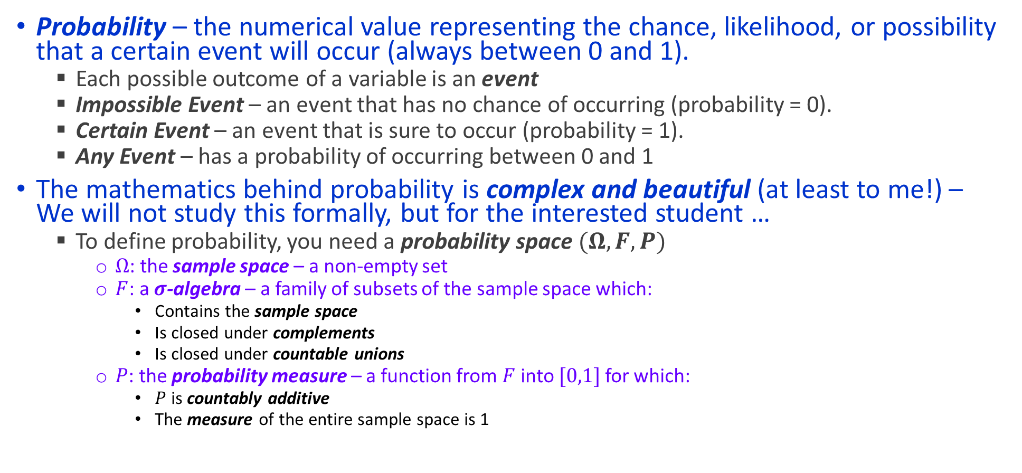
What is probability?
Probability – the numerical value representing the chance, likelihood, or possibility that a certain event will occur (always between 0 and 1).
Each possible outcome of a variable is an event
Impossible Event – an event that has no chance of occurring (probability = 0).
Certain Event – an event that is sure to occur (probability = 1).
Any Event – has a probability of occurring between 0 and 1
The mathematics behind probability is complex and beautiful (at least to me!) – We will not study this formally, but for the interested student …
To define probability, you need a probability space $(Ω, F, P)$
$Ω$: the sample space – a non-empty set
$F$: a $σ$-algebra – a family of subsets of the sample space which:
Contains the sample space
Is closed under complements
Is closed under countable unions
$P$: the probability measure – a function from $F$ into $[0,1]$ for which:
$P$ is countably additive
The measure of the entire sample space is 1

Slide 4
Basic Definitions
An outcome is a simple, atomic, result of an experiment. Every possible result of an experiment is an outcome
Ex: You toss a coin. There are two outcomes
Heads or Tails
Ex: You toss a die. There are six outcomes
1, 2, 3, 4, 5, 6
An event is a set of outcomes of an experiment (note: each outcome is also an event)
Ex: You toss a die. Here are possible events:
The result is even
The result is odd
The result is divisible by 3
The result is greater than or equal to 6
The collection of every possible event is the sample space

Slide 5
Measuring Probability
The probability of an event is:
This can be measured either a priori or empirically
a priori: Uses prior knowledge
Example: I flip a coin. What is the probability that the coin lands heads up?
Empirically: Uses observed data
Example: I survey 100 people in order to infer the proportion of individuals who purchase a large TV
Probability can also be subjective
Might depend on the person asked
Example: What is the probability that the launch of a new product is successful?

Slide 6
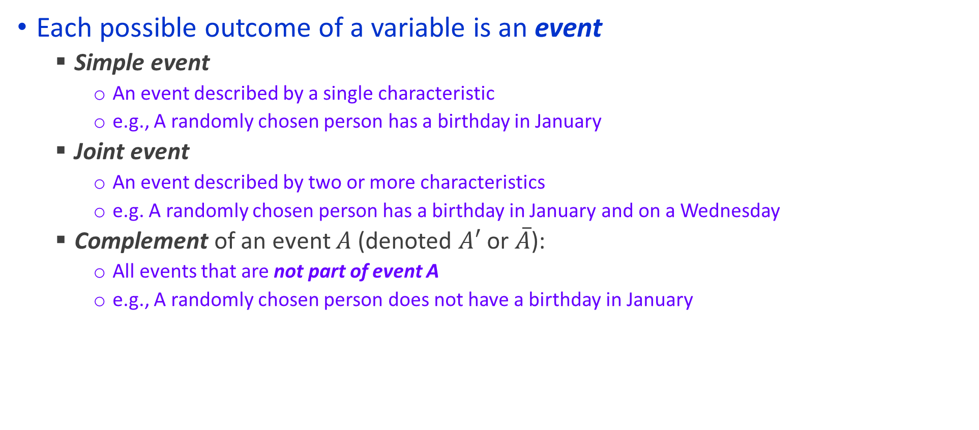
Events
Each possible outcome of a variable is an event
Simple event
An event described by a single characteristic
e.g., A randomly chosen person has a birthday in January
Joint event
An event described by two or more characteristics
e.g. A randomly chosen person has a birthday in January and on a Wednesday
Complement of an event $A$(denoted $A′$ or $\overline{A}$):
All events that are not part of event A
e.g., A randomly chosen person does not have a birthday in January

Slide 7
Simple Probability
Simple Probability refers to the probability of a simple event, which can be calculated from a contingency table
ex. P(Jan.)
ex. P(Wed.)
Jan. Not Jan. Total
P(Wed.) = 52 / 366
Wed. 4 48 52
Not Wed. 27 287 314
Total 31 335 366
P(Jan.) = 31 / 366

Slide 8
Joint Probability
Joint Probability refers to the probability of an occurrence of two or more events (joint event)
ex. P(Jan. and Wed.)
ex. P(Not Jan. and Not Wed.)
Jan. Not Jan. Total
P(Not Jan. and Not Wed.)
= 287 / 366
Wed. 4 48 52
Not Wed. 27 287 314
Total 31 335 366
P(Jan. and Wed.) = 4 / 366

Slide 9

Venn Diagram
Provide a graphical depiction of probability spaces
We think of the area in oval A divided by the area in the entire rectangle as the probability
This allows us the reason about joint probabilities
$A$ and $B$
A
B

Slide 10
Two important definitions
A family of events is mutually exclusive if no two of the events can occur simultaneously
Let A be the event that a randomly chosen person has a birthday in January
Let B be the event that a randomly chosen person has a birthday in February
A and B are mutually exclusive
How would you draw this in a Venn diagram?
A family of events is collectively exhaustive if one of the events must occur
Suppose you throw a die
Let A be the event that the result is an even number
Let B be the event that the result is less than or equal to 4
Let C be the event that the result is a prime number
A, B, and C are collectively exhaustive
How would you draw this in a Venn diagram?
Can you describe an experiment together with a set of events which are both mutually exclusive and collectively exhaustive? - Complements(A and Not A)
How would you dram this in a Venn diagram?

Slide 11
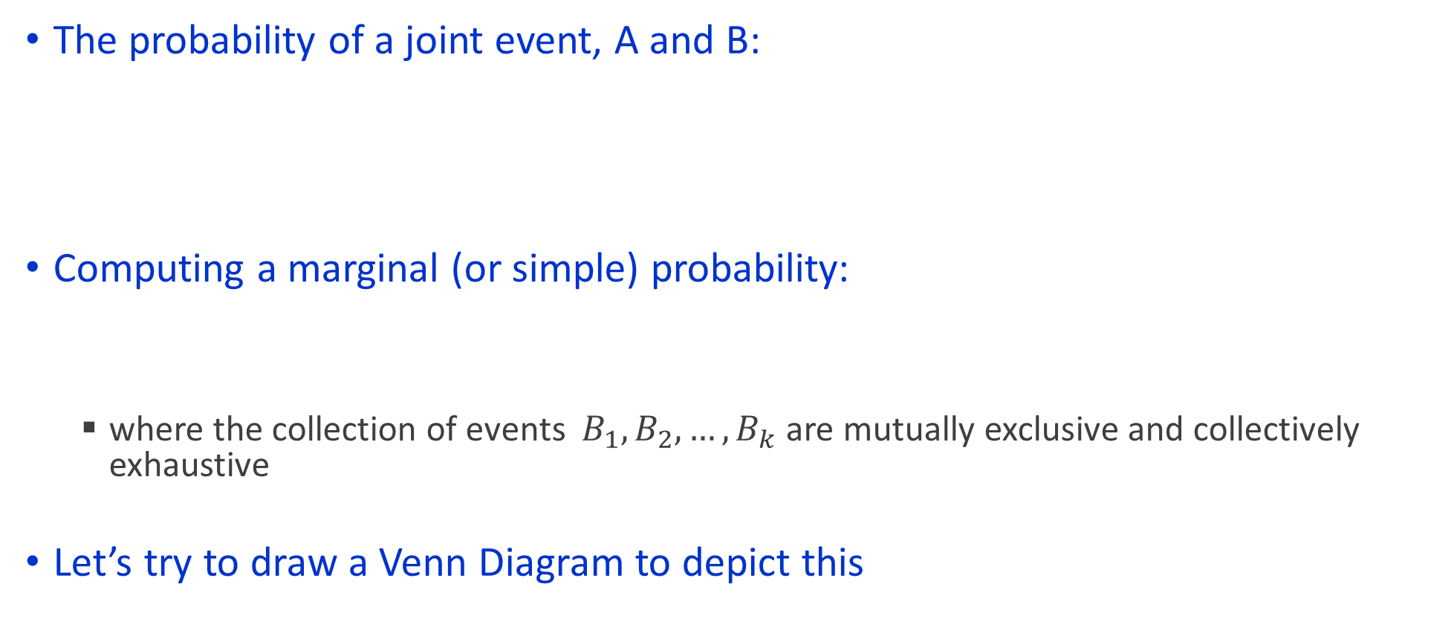
Computing Joint and Marginal Probabilities
The probability of a joint event, A and B:
Computing a marginal (or simple) probability:
where the collection of events $B_{1},B_{2},…, B_{k}$ are mutually exclusive and collectively exhaustive
Let’s try to draw a Venn Diagram to depict this

Slide 12
Joint Probability Example
P(Jan. and Wed.)
Jan. Not Jan. Total
Wed. 4 48 52
Not Wed. 27 287 314
Total 31 335 366

Slide 13
Marginal Probability Example
P(Wed.)
Jan. Not Jan. Total
Wed. 4 48 52
Not Wed. 27 287 314
Total 31 335 366

Slide 14
Contingency Tables
Event
Event
B₁
B₂
Total
A₁
P(A₁ and B₁)
P(A₁ and B₂)
P(A₁)
A₂
P(A₂ and B₁)
P(A₂ and B₂)
P(A₂)
Total
P(B₁)
P(B₂)
1
Joint Probabilities
Marginal (Simple) Probabilities

Slide 15
Properties of Probability
Probability is the numerical measure of the likelihood that an event will occur.
The probability of any event must be between 0 and 1, inclusively.
The sum of the probabilities of all mutually exclusive and collectively exhaustive events is 1.
1
Certain
0 ≤ P(A) ≤ 1 For any event A
0.5
0
Impossible
If A, B, and C are mutually exclusive and collectively exhaustive

Slide 16
Addition Rule
For any two events A and B the following is always true:
What happens if A and B are mutually exclusive? Does this simplify?
Here is an example:
P(A or B) = P(A) + P(B) - P(A and B)
P(Jan. or Wed.) = P(Jan.) + P(Wed.) - P(Jan. and Wed.)
= 31/366 + 52/366 - 4/366 = 79/366
Don’t count the four Wednesdays in January twice!
Jan. Not Jan. Total
Wed. 4 48 52
Not Wed. 27 287 314
Total 31 335 366

Slide 17
Conditional Probability
A conditional probability is the probability of one event, given that another event has occurred
Eg: Let A be the event that a clothing company will have revenue exceeding 1 million dollars next month
Consider P(A). Will this probability depend on what month of the year you choose?
If I tell you that you are in February or if I tell you that you are in November, will this probability change?
This yields the multiplication rule
The conditional probability of A given that B has occurred.
The conditional probability of B given that A has occurred.

Slide 18
Conditional Probability Examples
Of the cars on a used car lot, 70% have air conditioning (AC) and 40% have a GPS. 20% of the cars have both.
What is the probability that a car has a GPS, given that it has AC ?
How can we solve this problem? What is the problem asking for?

Slide 19
Calculating Conditional Probability
GPS
No GPS
Total
AC
0.2
0.5
0.7
No AC
0.2
0.1
0.3
Total
0.4
0.6
1.0

Slide 20
Independence of Events
Two events are said to be independent if and only if
Events A and B are independent when the probability of one event is not affected by the fact that the other event has occurred.
When two events are independent, the multiplication rule simplifies
Note: If A and B are independent, then
and the multiplication rule simplifies to:

Slide 21
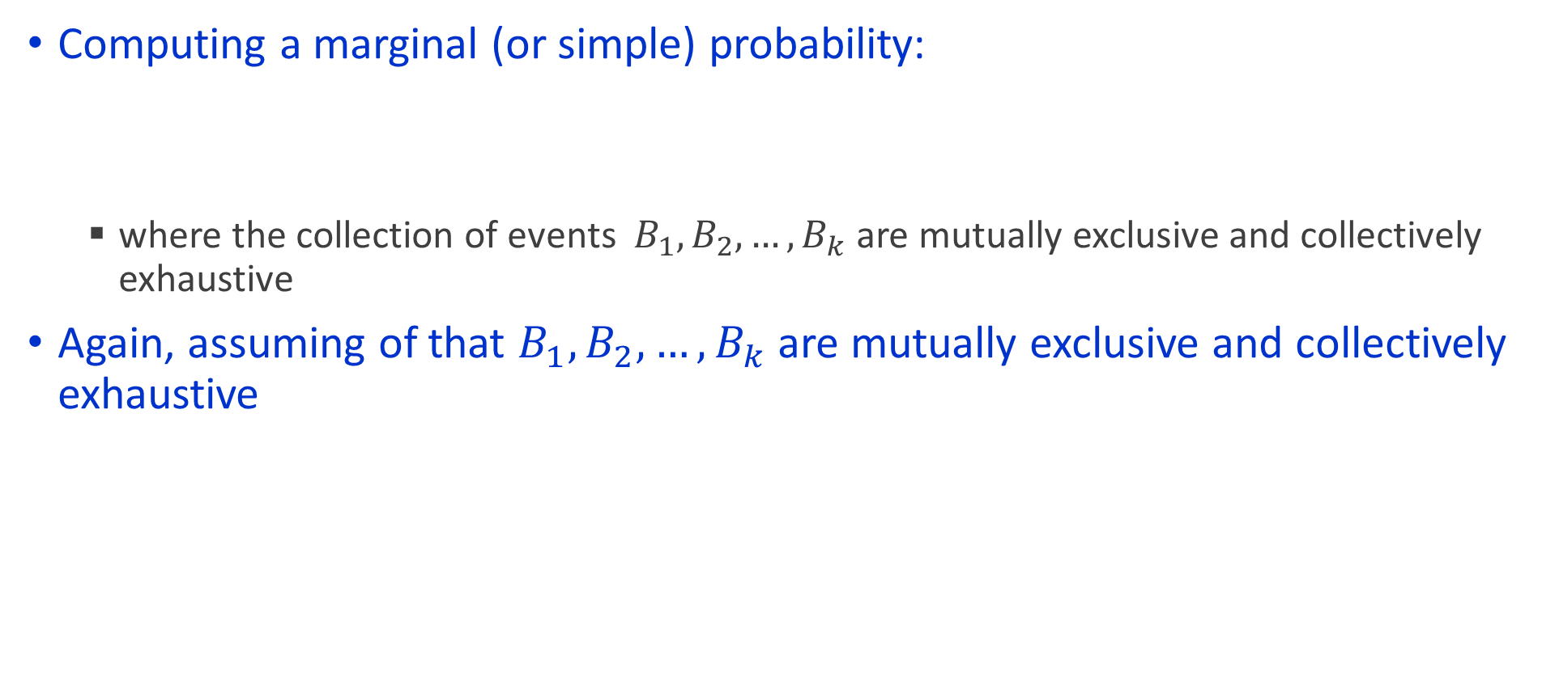
The Return of Marginal Probability
Computing a marginal (or simple) probability:
where the collection of events $B_{1},B_{2},…, B_{k}$ are mutually exclusive and collectively exhaustive
Again, assuming of that $B_{1},B_{2},…, B_{k}$ are mutually exclusive and collectively exhaustive

Slide 22
Bayes Theorem
Bayes’ Theorem is used to revise previously calculated probabilities based on new information.
Developed by Thomas Bayes in the 18th Century
One of the most famous and widely used formula in probability and statistics
An extension from the previous slide
where:
B_{i} = ith event of k mutually exclusive and collectively exhaustive events
A = new event that might impact P(Bi)

Slide 23
Bayes Theorem Example
A drilling company has a 40% chance of striking oil when they lay a new well in a given region. They ran a preliminary test to see if the new well will strike oil. The test concluded that the well will strike oil, but the test is not completely conclusive
Historically, when the well is successful, the test indicates that it will be successful 80% of the time
Historically, when the well is unsuccessful, the test indicates that it will be successful 30% of the time
What is the probability that a well is successful if the test indicates that it will be successful?
What is the probability that a well will be unsuccessful if the test indicates that it will be successful?

Slide 24
Birthday Problem
We have approximately 65 people in this class. What is the probability that at least 2 people share a birthday?

Slide 25
Monty Hall Problem
Game show
3 doors. 2 have goats behind them, 1 has a car.
You pick 1 door, and the game show host opens one of the other doors which has a goat (note that this is always possible)
Your decision: stick with your original door, or switch doors
You get the “prize” behind the door that you choose
Should you switch or stick with your original choice?

Slide 26
Counting Rules
Counting and probability goes hand-in-hand
Suppose an airline estimates that on a given route, there is a 5% chance of a customer cancelling their flight
What is the probability that at least 3 out of the 65 customers will cancel?
There a several counting rules that allow you to understand the number of possibilities

Slide 27
Counting Rule 1
Counting Rule 1:
If any one of k different mutually exclusive and collectively exhaustive events can occur on each of n trials, the number of possible outcomes is equal to
Example
Every bond is rated AAA, AA, A, BBB, BB, B, CCC, CC, C, or D by S&P. How many different ways can 4 bonds be rated?
K^{n}.

Slide 28
Counting Rule 2
Counting Rule 2:
If there are k₁ events on the first trial, k₂ events on the second trial, … and k_{n} events on the n^{th} trial, the number of possible outcomes is
Example:
A manufacturing company has to select vendors for three components of a widget that it is manufacturing. There are 3, 2, and 6 unique vendors, respectively, that sell these components. How many combinations of vendors can the company choose from to source the components?
(k₁)(k₂)…(k_{n}).

Slide 29
Counting Rule 3
Counting Rule 3:
The number of ways that n items can be arranged in order is
Example:
Your company’s homepage has four main links to display on its front page. How many ways can they order the links, from left to right?
n! = (n)(n – 1)…(1).

Slide 30
Counting Rule 4
Counting Rule 4:
Permutations: The number of ways of arranging X objects selected from n objects in order is
Example:
A jewelry store has five types of gems that they can put on display in their central display case to show to customers. It is known that the closer the gems are to the entrance to the store, the higher the expected sales, but there is only room to display three of the gems. How many different ways can the store choose to display the gems in the three slots?
Answer:

Slide 31
Counting Rule 5
Counting Rule 5:
Combinations: The number of ways of selecting X objects from n objects, irrespective of order, is
Example:
How many ways are there to select the three gems, if there is no difference where they are displayed, and we only care if a particular gem is chosen to be displayed?

